Slide 2
Poll Everywhere
Use your phone to text KARASTOECKER627 to the number 37607 to join
or
Use the website PollEv.com/karastoecker627
(If you don’t have your phone partner up)
Type your response through text once you have joined
Your answer should appear on the screen

Slide 3
Plate Tectonics
Standard: 8.EES2.4 Gather and evaluate evidence that energy from that earth’s interior drives convection cycles within the asthenosphere which create changes within the lithosphere including plate movements, plate boundaries, and seafloor spreading.
SEP: Developing and using models
CCC: Energy and matter
I can…
Name the three types of plate boundaries
Describe and model how the three types of plate boundaries move
Explain the geologic changes that each plate boundary creates

Slide 4
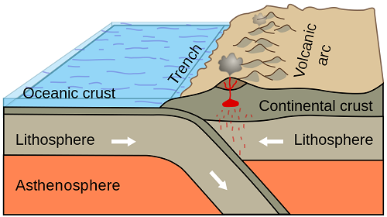
What layer is located under the asthenosphere?
Upper Mantle

Slide 5
What is Plate tectonics?
Earth’s surface is broken up into large pieces called tectonic plates.
The slow movement of these pieces form mountains and rift valley’s and cause volcanoes and earthquakes.

Slide 6
Convergent Boundary
What do you see in these pictures?

Slide 7
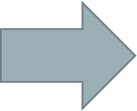
Convergent Boundary
A “colliding boundary”
Two plates move together
Oceanic -- Continental
The oceanic plate moves under the continental plate by subduction
Volcanoes and deep ocean trenches are formed through subduction
Why does the oceanic plate move under?
Continental--Continental
The crust folds pushing up mountains
EX: The Himalayas
Why do the two continental plates not slide under each other?

Slide 8
Divergent Boundary
What do you see in these pictures?

Slide 9
Divergent Boundary
A “spreading apart” boundary
Two plates move apart
Oceanic– Oceanic
New crust is formed where two oceanic plates move apart
New crust creates a mid-ocean ridge (label)
Continental– Continental
Two continental plates move apart and stretch the crust forming a rift valley (label)

Slide 10
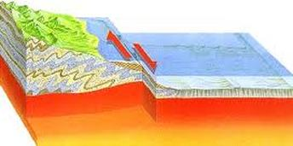
Transform Boundary
What do you see in this picture?

Slide 11
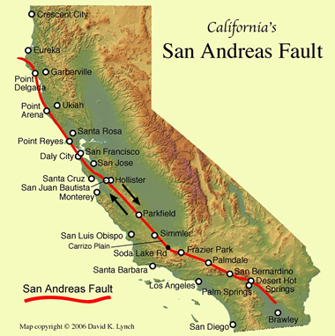
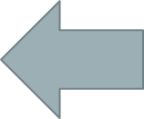
Transform Boundary
A “sliding” boundary
Two plates slide past each other and cause vibrations = earthquakes
EX: San Andreas Fault

Slide 12
Lets Model!
Quickly find a partner
Transform Boundary: Shoulder offset to partner’s shoulder facing opposite directions
Convergent Boundary: Hand to hand facing partner
Divergent Boundary: Back to back with partner

Slide 13
Cookie Plate Tectonics
You will be using an Oreo cookie to model and describe the different plate boundaries.
Do NOT touch your Oreo until instructed to do so.
We will work through the lab as a class.

Slide 14
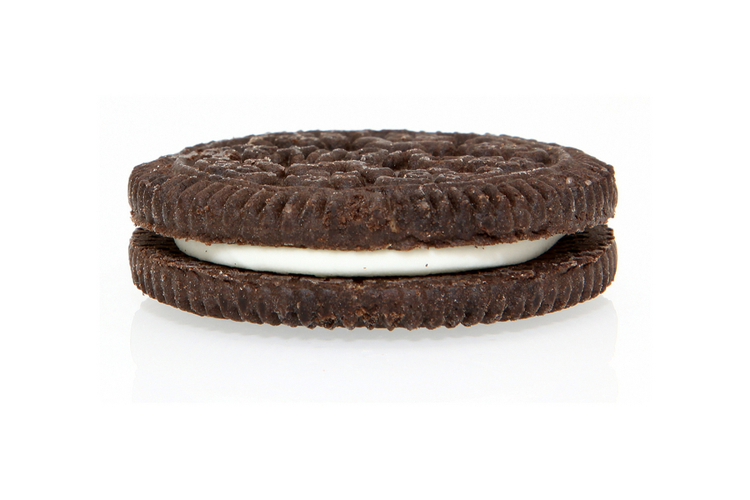
Task 1:
In the box on your lab sheet, draw and label the side view of your cookie model. Use the following terms as your labels:
Lithosphere
Asthenosphere
Lower Mantle
Lithosphere
Asthenosphere
Lower Mantle

Slide 15
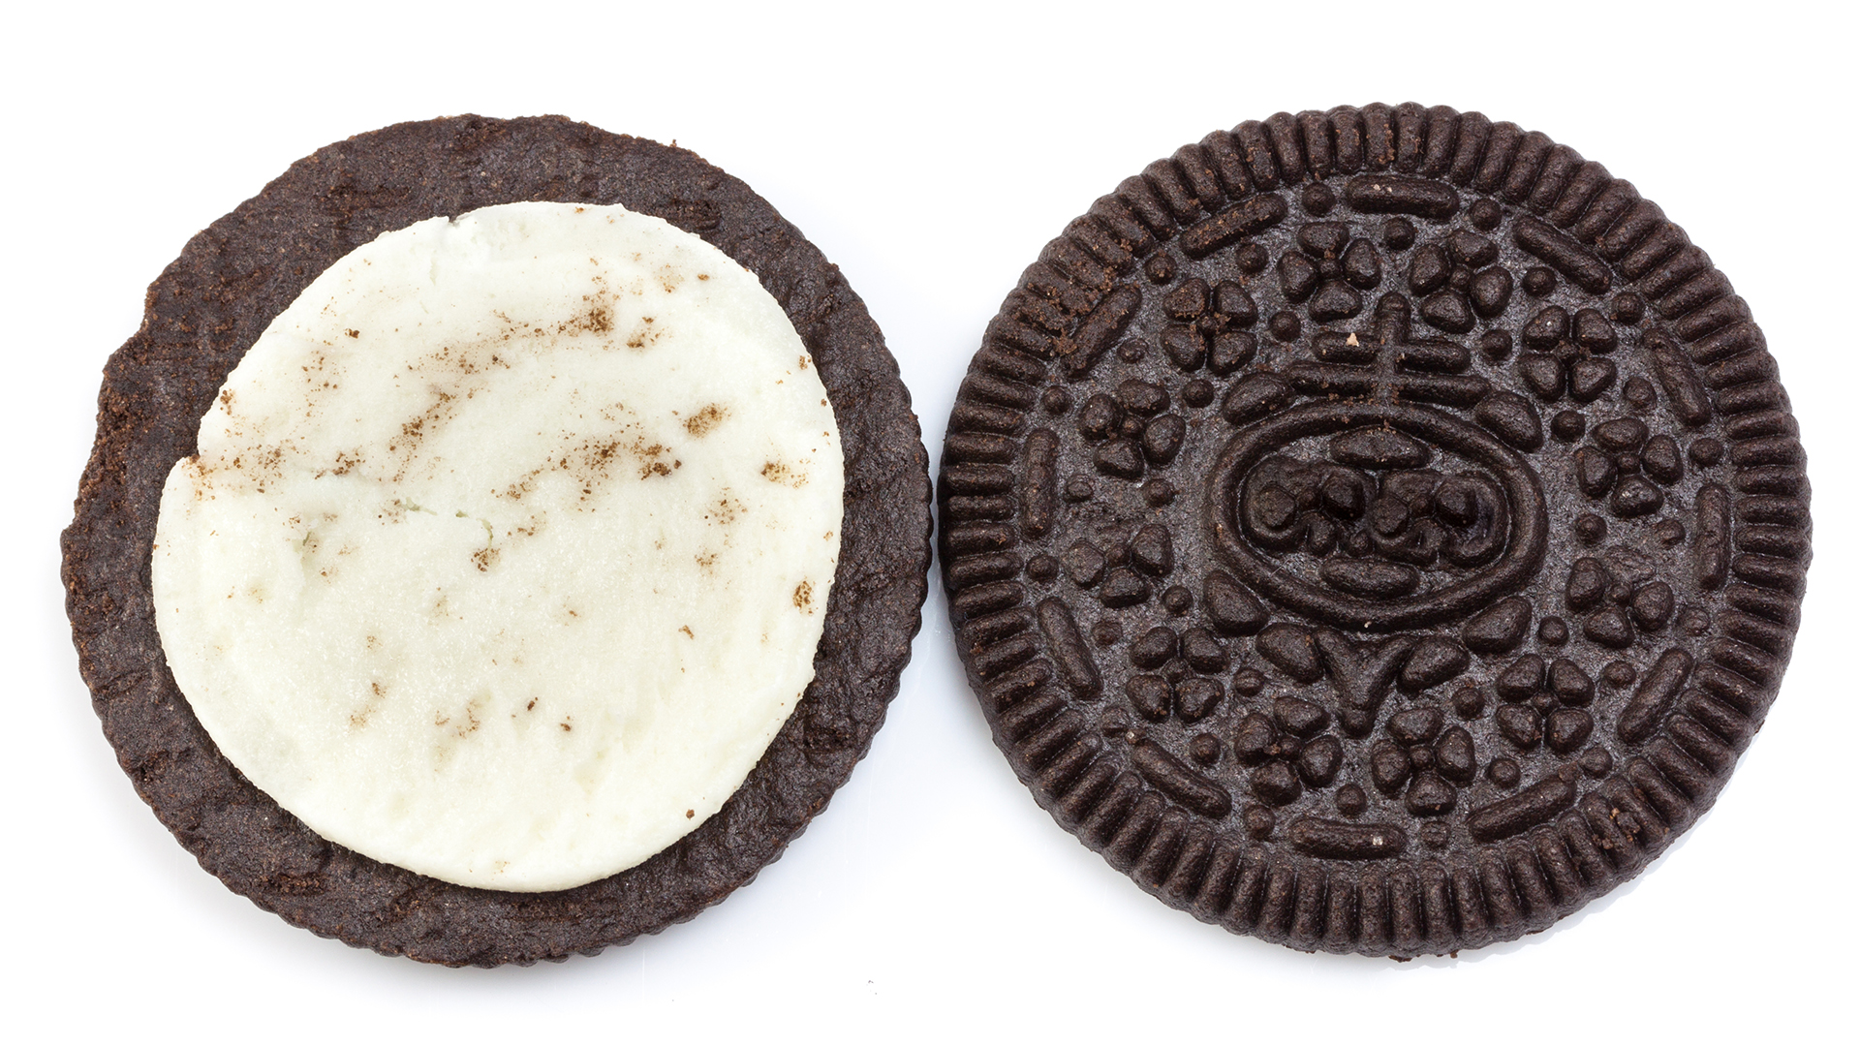
Procedure:
Separate the top cookie from the cream.
Break the top cookie in half to represent two tectonic plates.
Use your cookie to model the three different plate boundaries.

Slide 16
Plate Boundary Puzzles
With your lab table group you will assemble three different mini puzzles– one for each plate boundary.
When complete raise your hand for me to come check your work.
Turn in your Oreo lab before you leave!

Slide 17
Plate Tectonics
Standard: 8.EES2.4 Gather and evaluate evidence that energy from that earth’s interior drives convection cycles within the asthenosphere which create changes within the lithosphere including plate movements, plate boundaries, and seafloor spreading.
SEP: Developing and using models
CCC: Energy and matter
I can…
Name the three types of plate boundaries
Describe and model how the three types of plate boundaries move
Explain the geologic changes that each plate boundary creates

